Slide 1

REACTJS

Slide 2

HELLO!
I am Veena Kumaran
(Business Analyst and Freelancer)
You can find me at @VeenaKumaran27@gmail.com

Slide 3
You Will Learn...........
What is ReactJs
Why ReactJs?
Prerequisites to learn ReactJs
Buzzwords around ReactJs

Slide 4
What is ReactJs?
1

Slide 5

What is ReactJs?
ReactJs is a JavaScript library used for building fast and interactive user interfaces
It was developed by Facebook in the year 2011
Current version in use is 16.7.0
ReactJs follows a component based architecture

Slide 6
What is ReactJs?
Definition :
React is a component based, standard JavaScript library used for creating single page, fast and interactive UI

Slide 7
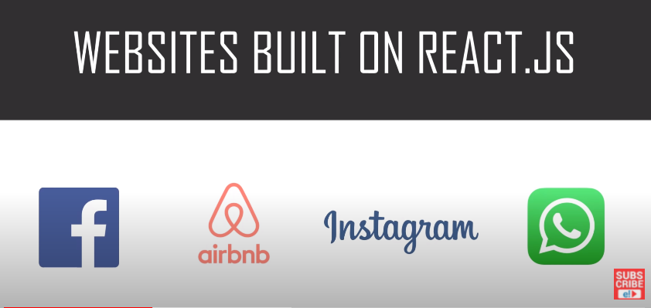
Websites built on ReactJs

Slide 8
Component Based Architecture
Component is a piece of the UI which is independent, isolated and reusable

Slide 9
State and Render methods
State() → describe the state of the element that is displayed (data)
Render() → describes what the UI should look like (component structure)

Slide 10
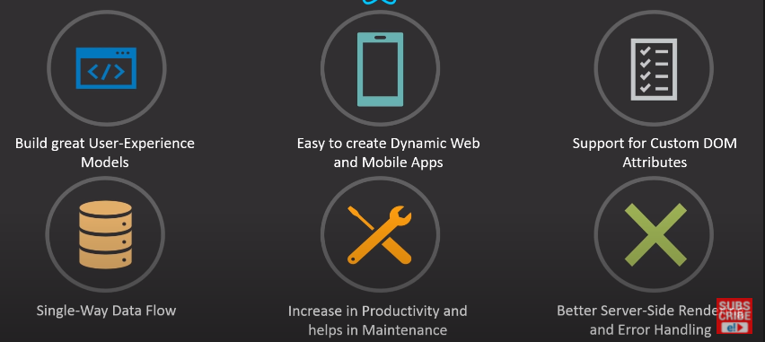
ReactJs Features

Slide 11
Why ReactJs?
2

Slide 12
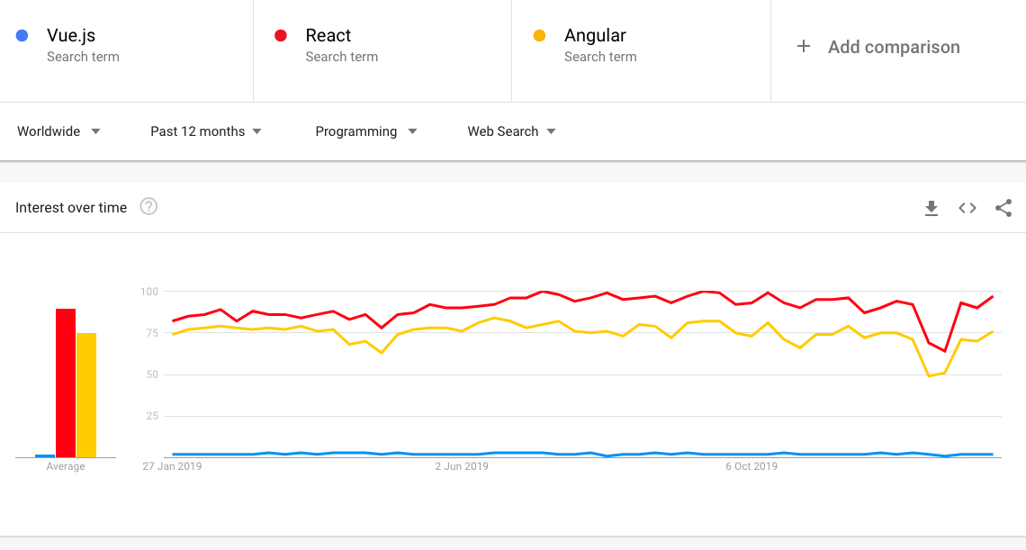
Trends – numbers speak for themselves

Slide 13
Prerequisites
3

Slide 14
Prerequisites
HTML
CSS
JavaScript
JSX
JSON
API

Slide 15
BuzzWords
4

Slide 16
MVC – Model View Controller
View
Model
Controller

Slide 17


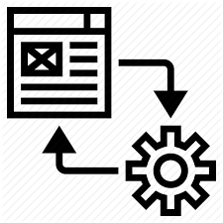
Full Stack
FULL STACK DEVELOPER
CLIENT SIDE
Web Application
HTTP REQUEST
SERVER SIDE
Business Logic
DataBase
API
HTTP RESPONSE
Front End Developer
Back end Developer
Query Languages

Slide 18
MEAN Stack vs MERN Stack
MEAN Stack
Mongo DB
Express Js
Angular Js
Node Js
MERN Stack
Mongo DB
Express Js
React Js
Node Js

Slide 19
Redux
Open Source Js library for managing the state of the objects/application

Slide 20
ENVIRONMENT SETUP

Slide 21
You Will Learn...........
Inspect React Pages
Install node.js
Create basic React app in primitive way
Create basic React app in modern way
Deploy applications using GIT and GitHub

Slide 22
Inspect React Pages
We can inspect React pages using the React Console present as an extension for all the browsers
Download React developer tools :
Search chrome extensions in browser >> chrome web store >> Search ‘React Developer tools’
Add this extension to chrome

Slide 23
Environment Setup
Node.js → Node is a server side cross platform (runtime environment) build on google chrome V8 engine for building fast and scalable n/w applications
Node is basically a collection of packages.
NPM → Node Package Manager
NPM is an interface to Node Js
Online Repo for Node Js packages/modules
Command line utility for Node.js packages
Node.js
package1
package3
package2
NPM
Local System

Slide 24
Environment Setup – Primitive Way
STEP 1 : Install Node
STEP 2 : Create a root folder manually in the required directory
STEP 3 : Generate the package.json file
STEP 4 : Install the Packages
> npm init
> npm install react --save
> npm install react-dom --save

Slide 25
Webpack and Babel
Webpack → module bundle used for setting the development server
Used for setting or changing the port for local host
Babel → Plugins required for Webpack
For eg : transpiler , compiler

Slide 26
Environment Setup – Primitive Way
STEP 5 : Install Webpack and Babel
STEP 6: create the required files : Index.html, Index.js, App.js and main.js
Once webpack-config file is generated, paste the default code in it to make it compatible
> npm install webpack --save
> npm install webpack-dev-server --save
> npm install webpack-cli --save
> npm install babel --save
> type nul > webpack-config.js

Slide 27
Environment Setup – Advanced Way
STEP 1 : Install Node
STEP 2 : Navigate to the required location(mainly as administrator) and launch the cmd prompt
The First command is used to install the create-react-app package from Node
Second command is used to create a react application without any build configuration and will create a project with all the required folders
> npm install –g create-react-app
> create-react-app nameofthefolder

Slide 28


Deploy Applications – GIT & GitHub
GitHub → Web based code-hosting platform used for code collaboration and version control.
GitHub is a remote repository for your codebase, where multiple people can work on the same code simultaneously.
GIT → Distributed version control system designed to track the changes in project files .
GIT is the heart of GitHub and is responsible for everything GitHub-related that happens locally on your computer.
Most Commonly used GIT commands :
GIT clone → clones or duplicates the repository into local
GIT commit → The git commit command will save all staged changes, along with a brief description from the user, in a “commit” to the local repository.
GIT checkout → The git checkout command is a way of switching between branches or version of your application
GIT Push and GIT Pull → will send changes in local to the repo and will accept incoming changes from repo to local

Slide 29
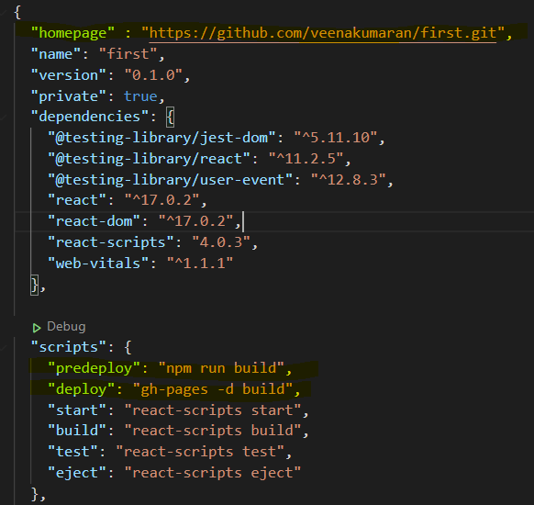
Deploy Applications – GIT & GitHub
STEP 1 : Create A GitHub Account
STEP 2 : Install Git in your machine and Set up Git.
STEP 3 : Install GitHub pages package as dev-dependency
STEP 4 : Add properties to package.json file
“hostname” : “repo link to your project”
"predeploy": "npm run build", "deploy": "gh-pages -d build"
> npm install gh-pages --save-dev

Slide 30
Deploy Applications – GIT & GitHub
STEP 5 : Create a new repo in GitHub and Initialize Git
STEP 6 : Deploy to GitHub pages
> git init
> git remote add origin “GitHub repo link”
> npm run deploy

Slide 31
FILE STRUCTURE IN REACT APP

Slide 32
File Structure
Package.json → stores the list of all node dependencies and the reference to packages installed from through npm
Index.html → starting point for the start of the application i.e. first page that is loaded when the application starts ( only html file – single page app )
It define the template of the browser screen
Index.js → renders or maps the content to the elements/div in index.html
App.js → it is the main component which contains all other components ( container )
Webpack-config.js → for setting up the development server or local host

Slide 33
UNDERSTANDING UI ORIENTATION

Slide 34
UI Screen Template
The entire UI is divided into multiple <div>
Index.html file defines the orientation of the page i.e. the number of <div> the page is dived into broadly
div1
div3
div2

Slide 35
UI Screen Content
For each of the <div> we need to specify the html content that needs to be displayed
Index.js file maps the html content/elements to the <div> tags
div1
HTML Element
HTML Element
div3
div2
HTML Element

Slide 36
SAMPLE REACT APP

Slide 37
Sample React App
To get started, first create a new application.
For any application we essentially have 2 important parts in the program
#1: Creating an Element
#2: Rendering an Element
NOTE : Elements are basically html tags and enclosed content that we want to display on the output

Slide 38
Creating an Element
Create an element :
Create Element
(
‘Tag name’,
Attributes,
Html Content
)
SYNTAX
Const tilte = React.createElement (
‘h1’,
{ id: ‘title’ },
“Hello World”
)
arguments

Slide 39
Rendering an Element
Render an element :
Render Element
(
What you want to render,
Where you want to render
)
SYNTAX
ReactDOM.render (
‘title’,
Document.getElemetById (‘root’)
)
arguments

Slide 40
JSX

Slide 41
JSX Syntax
JSX is basically using html tags directly inside JavaScript code
In JSX,
All expressions are written in { }
These expression include variables, properties or any other Js expression.
NOTE:
In HTML if you want to give Js expression, we use → { }
In HTML, if you want to define any property: value pair i.e. attributes then we use → {{ }}

Slide 42
JSX
In traditional JavaScript, we have output methods to display content on output but now using JSX, we can directly write/embed html content/tags in JavaScript without the output methods
Embedding html content directly to render function
Embedding html content indirectly to render function

Slide 43
JSX
Embedding html content directly to render function
Embedding html content indirectly to render function
ReactDOM.render(
<h1>My Webpage</h1>,
document.getElementById('root')
);
var element = <div><h1>My Webpage</h1><p>hi there........</p></div>
ReactDOM.render(
element,
document.getElementById('root')
);

Slide 44
Different types of data in JSX

Slide 45
Different types of Data in JSX
The different types of data which we can use in JSX are
Variable
Object
Arrays/ lists
Array Object

Slide 46
STYLING

Slide 47
JSX Styling
There are different ways to style content in JSX:
Inline or internal
Using External .css file
Using Modules
Styled components

Slide 48
Inline Styling
In inline styling we can give the styles as follows :
#1 : directly in the tags as attributes
<h1 style ={{backgroundColor : 'black', color : 'orange', textAlign :'center’}
#2 : As style objects
<h1 style ={myStyle}> My Webpage </h1>

Slide 49
External Styling
In external Styling, we can give the styles as follows :
#1 : external css for tags
body {
margin: 0;
font-family: -apple-system, BlinkMacSystemFont, 'Segoe UI', 'Roboto', 'Oxygen',
'Ubuntu', 'Cantarell', 'Fira Sans', 'Droid Sans', 'Helvetica Neue',
sans-serif;
}
#2 : external css classes
.txt{
font-size: 200px; }

Slide 50
JSX Styling
There are different ways to style content in JSX:
Inline or internal
Using External .css file
Using Modules
Styled components

Slide 51
COMPONENTS

Slide 52
Components
Components are building blocks of any React Application, which aims at increasing the modularity of the elements that need to be rendered on the UI i.e. how a section of the UI should appear
There are 2 main types of components in React Js
Class component
Functional component

Slide 53
Components
Component
INPUT : (optional)
Props
OUTPUT :
React Element (HTML)

Slide 54
Class Components
SYNTAX FOR DEFINING A CLASS COMPONENT
class Message extends React.Component
{
render()
{
return(
<h1 style = {style_h1}> My Webpage </h1>
)
}
}
SYNTAX FOR REFERENCING A CLASS COMPONENT
ReactDOM.render(
<Message/>,
document.getElementById('root')
)

Slide 55
Class Components
Any variables, objects, arrays, function declared here are global
Here everything needs to be defined with the datatype and accessed by the name directly in the class
class Class_Name extends React.Component
{
Any variables, objects, arrays, function declared here are local
Here everything needs to be defined without the datatype and accessed by the ‘this’ keyword in the class
render()
{
Any variables, objects, arrays, function declared here are global
Here everything needs to be defined with the datatype and accessed by the name directly in the class
return(
<h1 style = {style_h1}> My Webpage </h1>
)
}
}

Slide 56
Functional Components
SYNTAX FOR DEFINING A FUNCTIONAL COMPONENT
function Message()
{
document.write("hey do you want to login?")
return(<p> Welcome….</p>)
}
SYNTAX FOR REFERENCING A FUNCTIONAL COMPONENT
ReactDOM.render(
<Message/>,
document.getElementById('root')
)

Slide 57
Functional Components
Any variables, objects, arrays, function declared anywhere in a functional component are global
Here everything needs to be defined with the datatype and accessed by the name directly in the function
function Message()
{
document.write("hey do you want to login?")
return(<p> Welcome….</p>)
}

Slide 58
Components
We can declare the components in separate .js files and then import them into our index.js file
We can also define all our components in a different file (eg : App.js) and we can export them from App.js and then import them in index.js
export {App, Apple, Mango}; --App.js file
import { Apple, Mango, App } from './App’; -- index.js file

Slide 59
Functional Components
Functional Components | Class Components
Absence of this keyword | this keyword is used for local var, obj and functions
No concept of state | Stateful
Presentational components | Provide lifecycle hooks

Slide 60
Different types of Functional Components
Normal function
function Hello()
{
return(<p>hi there….</p>)
};
Arrow function
const Hello = () => {
return(<p>hi there…..</p>)
} };

Slide 61
FUNCTIONS vs EVENTS

Slide 62
Functions
There are 2 types of functions:
Normal function
Arrow functions
These functions can also be used without the datatype specified inside the class, can be called using ‘this’ keyword
The values that you pass to a function are known as arguments

Slide 63
Normal Functions without Arguments
SYNTAX FOR FUNCTION DEFINITION
function Hello()
{
document.write("hey do you want to login?")
return(<p>Hello….</p>)
}
SYNTAX FOR FUNCTION CALL
<p>{Hello()}</p>

Slide 64
Normal Functions with Arguments
SYNTAX FOR FUNCTION DEFINITION
function Hello(x)
{
return(<p>Hello….{x}</p>)
}
SYNTAX FOR FUNCTION CALL
<p>{Hello(‘veena’)}</p>

Slide 65
Arrow Functions without Arguments
SYNTAX FOR FUNCTION DEFINITION
const=Hello()=>
{
document.write("hey do you want to login?")
return(<p>Hello….</p>)
}
SYNTAX FOR FUNCTION CALL
<p>{Hello()}</p>

Slide 66
Arrow Functions with Arguments
SYNTAX FOR FUNCTION DEFINITION
const=Hello(x)=>
{
document.write("hey do you want to login?")
return(<p>Hello….{x}</p>)
}
SYNTAX FOR FUNCTION CALL
<p>{Hello(‘veena’)}</p>

Slide 67
Events vs Functions
Event is any function that is triggered as a result of user input.
Basic differences between Event and Function :
The way of calling an event or function
There is slight difference in the syntax while calling a function and calling an event
What is returns as output
Function can return anything → html content or JS output methods
Events can return only JS output methods

Slide 68
Events
SYNTAX FOR EVENT DEFINITION : SAME AS DEFINING FUNCTIONS (NORMAL, ARROW OR LOCAL )
SYNTAX FOR EVENT CALL (WITHOUT ARGS)
<button onClick= {Hello} Logout</button>
SYNTAX FOR EVENT CALL (WITH ARGS)
<button onClick={()=>Hello('veena')}>Logout</button>

Slide 69
Events in Components
When ever events are declared as functions inside class, (unlike normal functions) it does not have access to ‘this’ keyword .
Thus it will not be able to access the local variables defined in the class in the class
For this we have 3 solutions
Binding the event handler
Convert the existing event handler function to an arrow function
Declare the event handler as a global function

Slide 70
PROPS

Slide 71
Props
Any value that we want to pass to a component (class/functional) to make the component dynamic, is known as props.
Till now, we have discussed about both local and global variables in the components while defining the components.
In this section, we will be discussing about how we can pass variables to the component during the component declaration.
The variables that are passed to the component, during the declaration of the component are known as props.

Slide 72
Props
Any value that we want to pass to a component (class/functional) to make the component dynamic, is known as props.
Till now, we have discussed about both local and global variables in the components while defining the components.
In this section, we will be discussing about how we can pass variables to the component during the component declaration.
The variables that are passed to the component, during the declaration of the component are known as props.

Slide 73
Passing different types of Props to Component
Rules :
All strings type props are passed enclosed in “ “
All other type of props like numeric and object are passed enclosed in { }
We can pass multiple props to a component, need not be separated by a , (comma)
Passing props directly to the component :
<Book title=“The King” pages ={100} />
2. Passing variables as props :
<Book title= {x} />

Slide 74
Passing different types of Props to Component
Passing objects as props :
(we can either pass the entire obj or just the properties in the object)
<Book completeobject = {obj} name={obj.name}/>
Passing Arrays as props :
<p>Markslist : {this.props.marks.map((item) => <li> {item.score} </li>)} </p>
We need to define an array named marklist and send it as props to the Component Marks as so :
<Marks marks = {marklist}/>,

Slide 75
Passing Props from Component to functions
The functions where we need to pass the props can either be defined inside the component or outside the component
In case of Class Components,
if the function is declared outside the Class Component , it will be accessed by the name of the function
function_name (this.props.value)
if the function is declared inside the Class Component , it will be accessed by this keyword followed the name of function
this.function_name (this.props.value)
In case of Functional Components,
No matter where you define the function it will always be access by the name of the function in the component
Function_name(props.value)

Slide 76
defaultProps
Default Props are useful when we want to pass default values to an array or an object array.
When ever there is no data that comes as response instead of the code breaking for these values, default values are printed.
If the component call is not passing any props, but the component still is accessing the props, then defaultProps come in handy
static defaultProps = { //object
books : [ //key
{'title' : 'default title' , 'author' : 'default author'} //values
]
}
NOTE : we will always declare ‘defaultProps‘ in the component which is accessing it (through the map function)
i.e. the one that is passing the props

Slide 77
propTypes
PropTypes are used to specify the type of the props for easy understanding and code readability.
Does not have any technical impact.
NOTE: in order to use propTypes we need to import it using this command :
import propTypes from 'prop-types’
Library.propTypes ={
title : propTypes.string,
pages : propTypes.number
}

Slide 78
STATE

Slide 79
State
State is an object in react used to store the properties/variables for which the state needs to be updated.
setState( ) is the method which takes as argument the variable or property, that needs to be updated.
Defined as :
State :
{
Key : ‘value’,
}
Updated as :
this.setState( { key : this.state.key +1 } )

Slide 80
PARENT- CHILD COMPONENTS

Slide 81
Parent → Child
Just like we can call a component from render method we can also call a component from inside of another component.
From the render function we will call <Parent/> → from Parent we will call </Child>
From parent to child, we can pass normal props
<B status='a is active'>
From parent to child we can pass html content as props
Child component
<p>{this.props.status}</p>
Parent component
Child component
<B><p>hi there i am A</p></B>
<p>{this.props.children}</p>
Parent component

Slide 82
State
We can change the state or pass some values to the child using props
But if we want to change the state or pass some values back to the parent from child, we need to use function call-backs
Props
PARENT
CHILD
Call-Back Functions

Slide 83
BIG CONCEPT

Slide 84
THANKS!
Any questions?

